Slide 1
Surface trap setup
Li He
December 14
2017

Slide 2
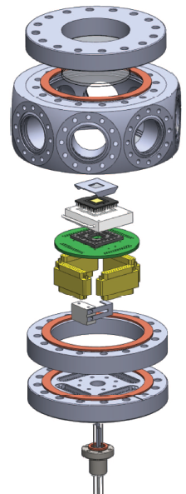
Date：9.4
Chamber
Assemble-No sit
70.61
mm
35.3
mm
Chip 0.5mm
Spacer ~1.5mm
2.3mm
11.6mm
55.1mm
5.0mm针插座
47.4
1.5mm
25mm（包含pcb pin焊锡）
19.8
mm
Distance between Trap and chamber middle：
Above the chamber middle:55.1-47.4=7.7

Slide 3
Date：9.4
Objective WD 13mm
36mm
35.3
2.725
3.175
7.7mm
7mm
trap
27.6mm
70.6mm

Slide 4
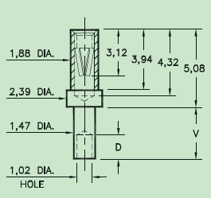
插2.5*4.5*5.8（长）mm针
5.5~8mm
焊在 1.5mm厚pcb 板

Slide 5
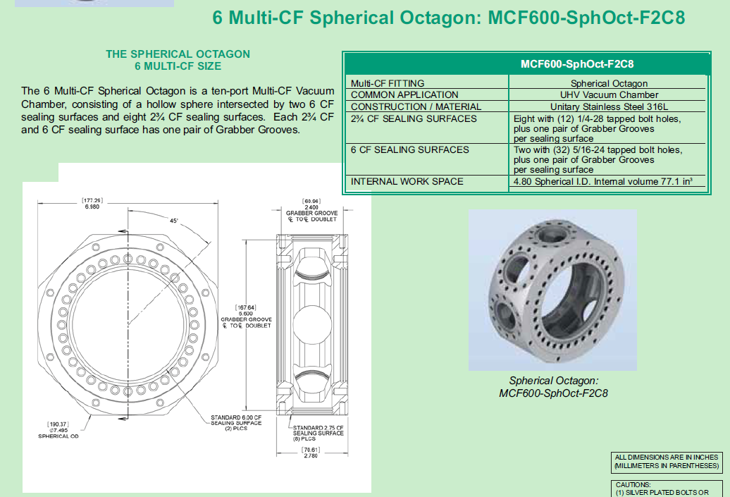
Spherical Octagon

Slide 6
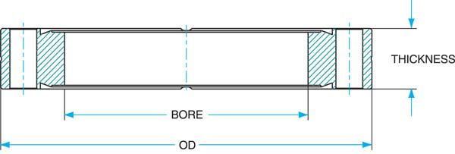
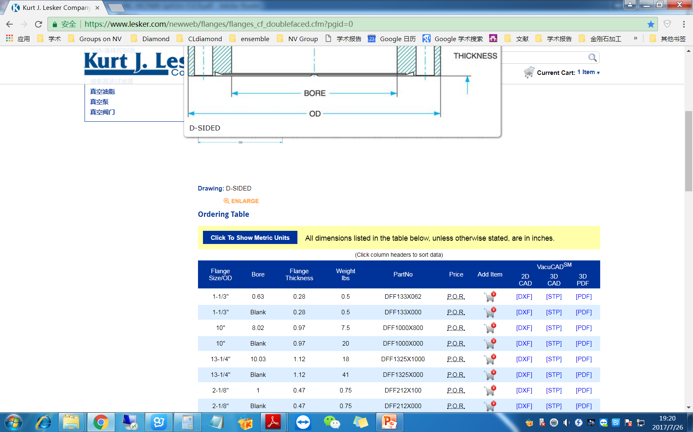
Double faced CF Frange
6" | 4.01 | 0.78 | 3.5
19.8mm

Slide 7
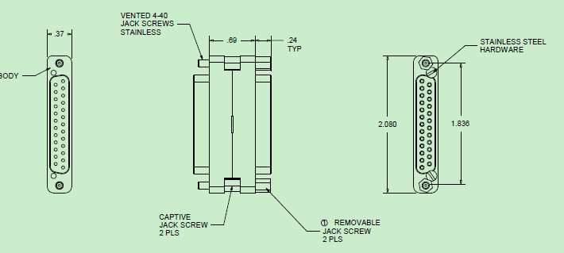
DSUB
Thickness：0.69+0.24=0.93’’=23.6mm

